Slide 1
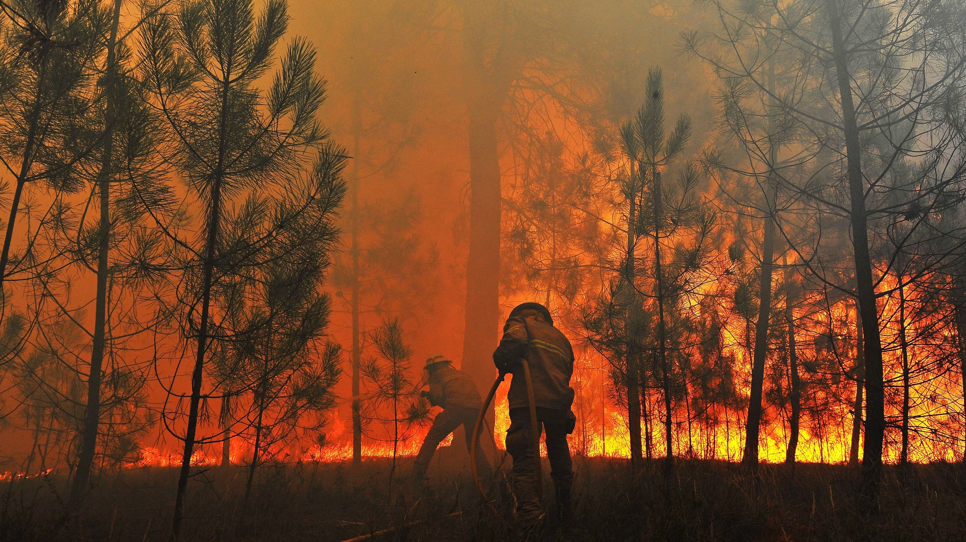
The fires in Portugal
Simão Lopes, 2022

Slide 2
The problem
Is it possible to predict the amount of burnt area from the available data and use it to optimize resources?

Slide 3
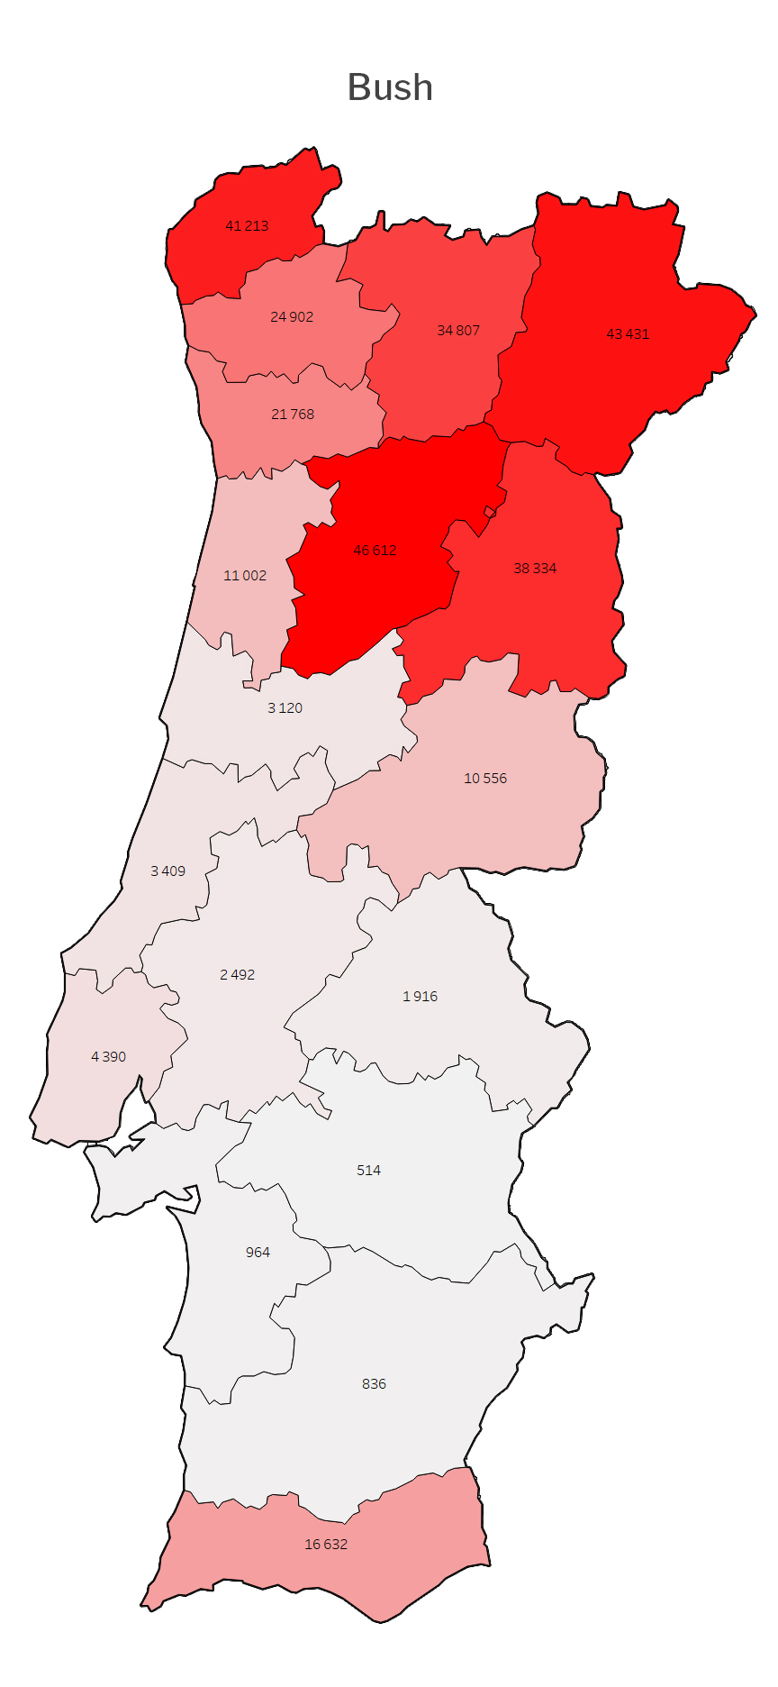
The macro view Portugal
Different types of terrain have their hot spots.
2017 was excluded since it was an abnormal year and completely skews the reality.
Notes:
2017 wasn’t a typical year, so I discarded it.

Slide 4
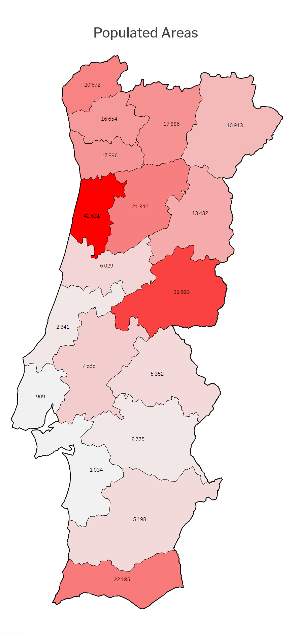
The macro view Portugal
Different types of terrain have their hot spots.
2017 was excluded since it was an abnormal year and completely skews the reality.
Notes:
2017 wasn’t a typical year, so I discarded it.

Slide 5
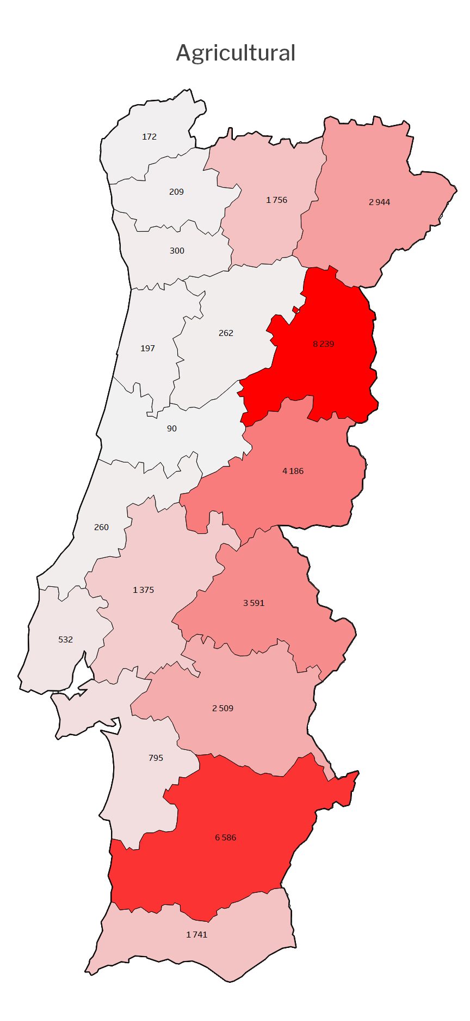
The macro view Portugal
Different types of terrain have their hot spots.
2017 was excluded since it was an abnormal year and completely skews the reality.
Notes:
2017 wasn’t a typical year, so I discarded it.

Slide 6
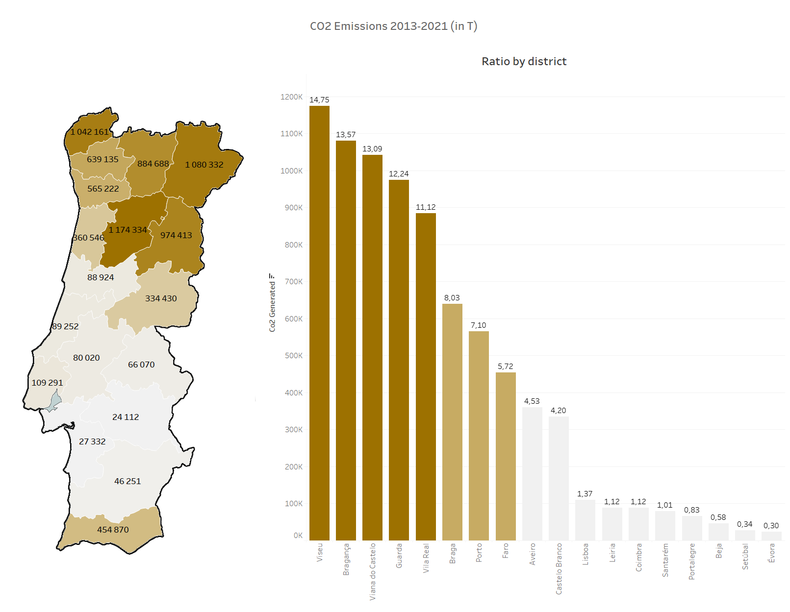
Is the burnt area a good metric?
A lot of factors come into play, but the emissions generated by the fires are the biggest problem as they affect the quality of the air.
CO2 calculation method:
X(t) = (bush_area* bush_area_fuel_coeficient + populated_area* populated _area_fuel_coeficient + agricultural_area* agricultural_area_fuel_coeficient)*Emission_Factor
In: Tiago Silva, José Pereira, José Paúl, Maria Santos, Maria vasconcelos – Estimativa de emissões Atmosféricas de fogos rurais em Portugal
Notes:
Top 5 have more than 60% of all emitted co2.

Slide 7
12 989 826
Co2 in T since 2013

Slide 8
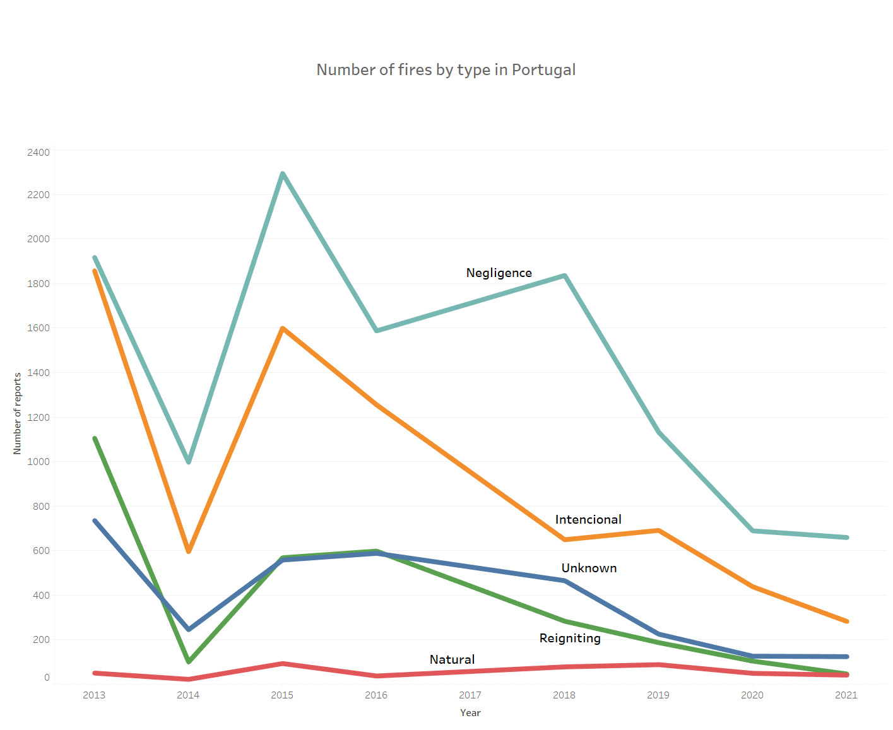
Are natural fires relevant?
No, they are not, but we can look deeper and see interesting results:
Negligent fire is a problem in Portugal.
The number of fires is decreasing.
Notes:
Negligence fires are the most prevalent, followed by intencional.

Slide 9
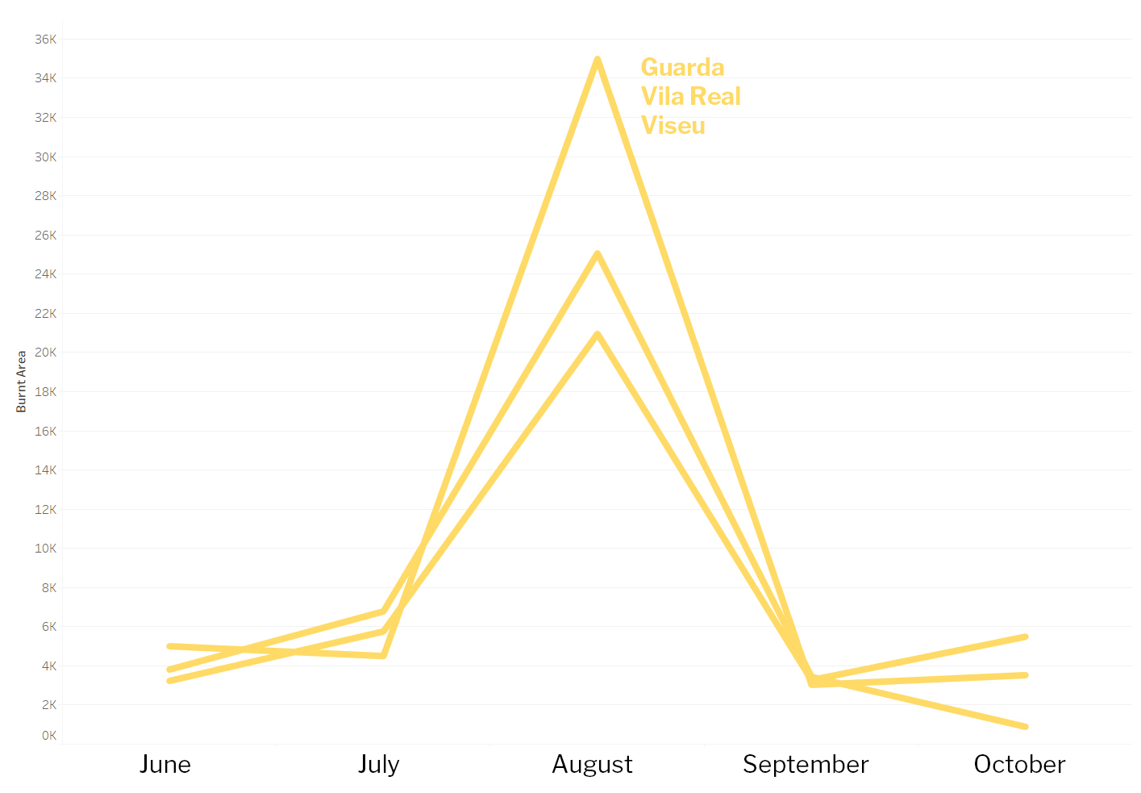
Are the monthly fire count and burnt area distribution the same for all top 5 districts?
Notes:
Only showing the worst 5 months, the worst ones.

Slide 10
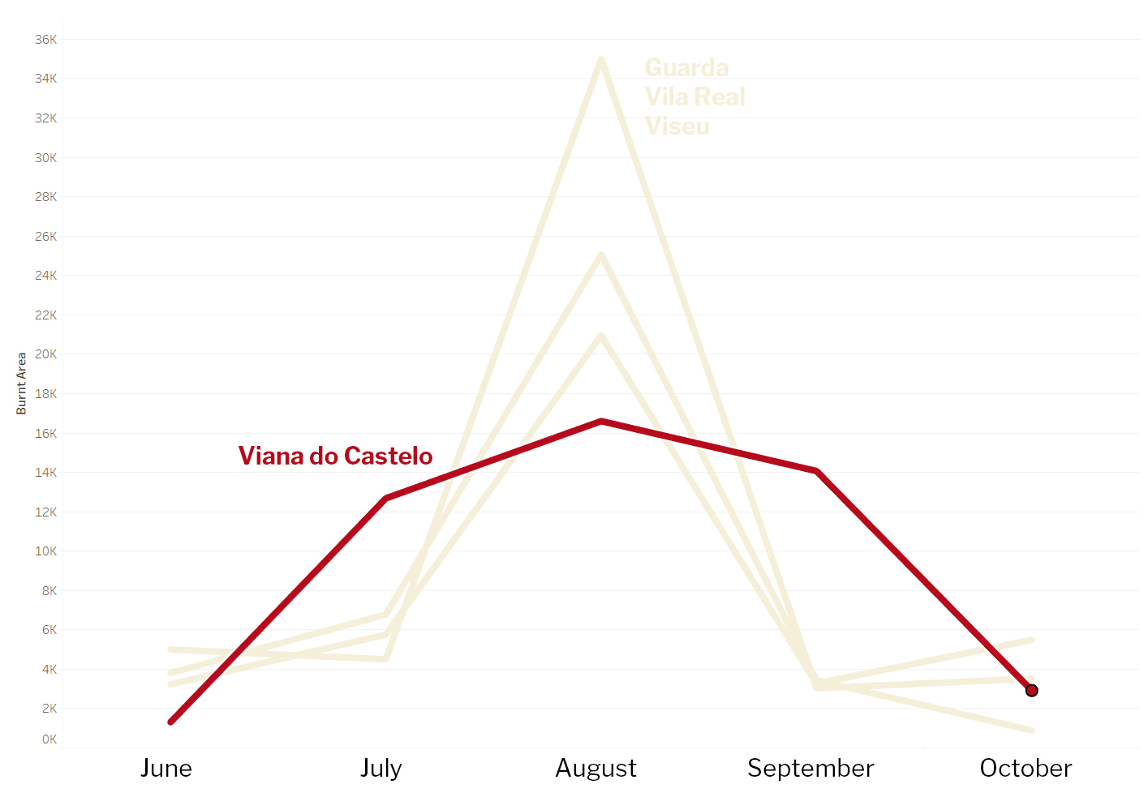
Are the monthly fire count and burnt area distribution the same for all top 5 districts?
Notes:
Only showing the worst 5 months, the worst ones.

Slide 11
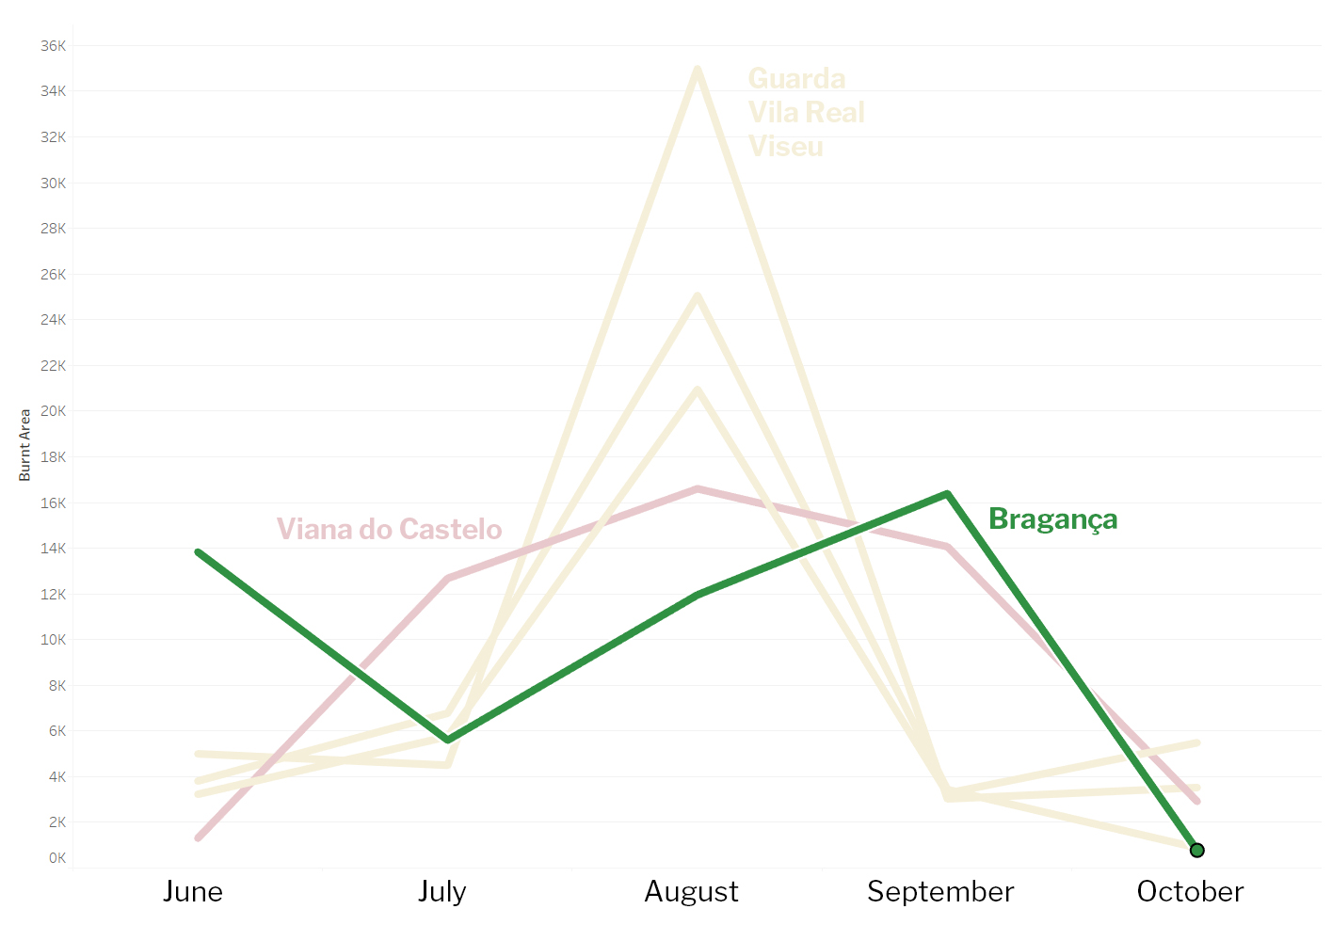
Are the monthly fire count and burnt area distribution the same for all top 5 districts?
Notes:
Only showing the worst 5 months, the worst ones.

Slide 12
Do the top 5 districts have a higher rate of fires?
Hypothesis 1
Notes:
No, its actually quite lower. The mean of fires in the top 5 is 6353, while the country as whole has a mean value of 6814 fires per district.

Slide 13
Do the top 5 districts have a higher re-ignition rate?
Hypothesis 2
Notes:
Yes they have. Almost double if we compare to the country.

Slide 14
Do we have data to predict the burnt area?

Slide 15






WE DO!
GPS DATA
Fire Weather
Index System
TIME STAMPS

Slide 16
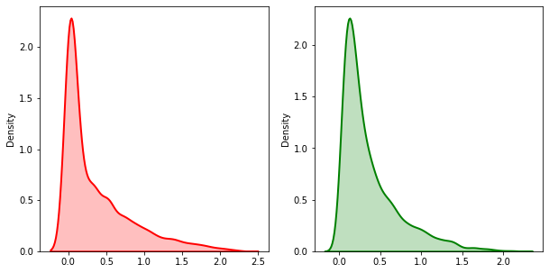
The original data can’t be used without real cleaning, if a model is built around this data it will completely skew the reality.
The data input is for sure one of the things that should be improved since the impact is big on everything from simple plots to prediction models.
Real Results Model results
R2 score of 63%
Better results possible with further iteration and neural networking

Slide 17
Conclusions
Re-ignition is a serious problem, significant resources should be allocated in the aftermath of the fire.
Use the predictive models to allocate resources in advance.
Promote global campaigns instructing people how to prevent negligent fires.

Slide 18
What’s next?
Notes:
Only scratched the surface, some of the next steps are:
Pickup the districts where the major cause is intencional and try to cross reference it with local timber business and criminal data.
Understand why the investigation of fires fails so much in some countys as Pt. De lima in Viana.
Cross referencing the fire spread rate with the the amount of maintenance done to the forest.
Endless possibilities.

Slide 19
Full research and project at GitHub
github.com/Simao-Lopes/Fire-Project

Slide 20
Sources
Nuzulul Khairu Nissa, The Experiment of Forest Fires Prediction using Deep Learning -https://medium.com/mlearning-ai/the-experiment-of-forest-fires-prediction-using-deep-learning-d537e8c8e3a2
Fire Weather Index (FWI) System - https://www.nwcg.gov/publications/pms437/cffdrs/fire-weather-index-system
Jorge Miguel Gomes, A repository for ICNF data - https://github.com/vostpt/ICNF_DATA
Paulo Cortez & Anibal Morais, A Data Mining Approach to Predict Forest Fires using Meteorological Data
Joana da Fonseca Valente, Modelação do fogo florestal e os seus impactes na qualidade do ar.

